Slide 1
Can Care by Foreign Domestic Helpers Be an Alternative Long-term Care Option: Strengths and Challenges? 外傭照顧：是否居家安老的希望？
15th World Congress on Long Term Care in Chinese Communities
cum
25th Annual Congress of Gerontology &
7th Cross-border Elderly Care Seminar
Professor CHONG, Ming-Lin Alice
Department of Social and Behavioural Sciences
City University of Hong Kong

Slide 2
Contents
Introduction
Foreign Domestic Helpers and Ageing-in-Place: Strengths and Challenges
Overseas Foreign Domestic Helpers Related Policies
Policy Recommendations

Slide 3
Introduction Hong Kong: An Ageing Society
By 2046, one-third of Hong Kong population will age 65 or above
By 2046, life expectancy of men will be 85.4 years-old while female will be 91.4 years-old
Notes:
Census & Statistics Department. (2017). Hong Kong Population Projections 2017-2066.

Slide 4
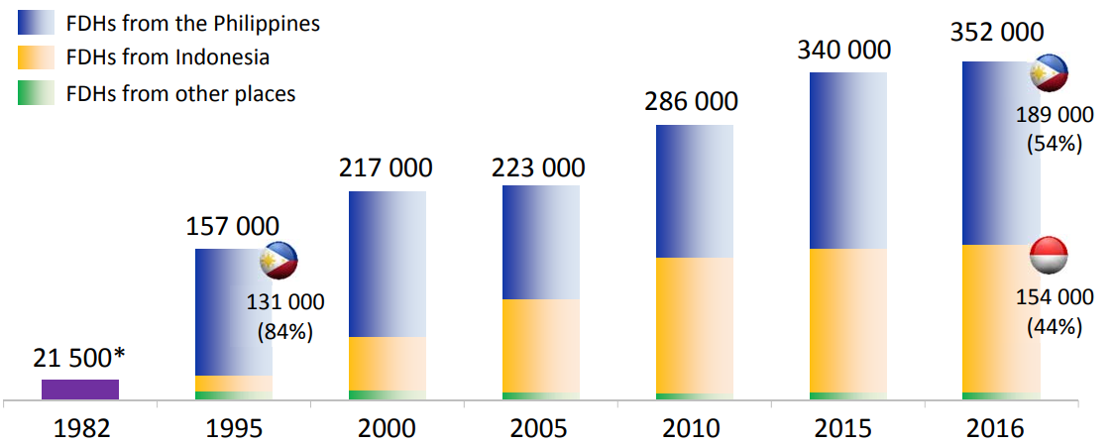
Introduction Foreign Domestic Helpers (FDHs) in HK
Domestic helpers, local & non-local, are increasingly employed to take care of frail elders in many industrialized societies, including Hong Kong (Ayalon, 2010; Keryk, 2010)
Notes:
Insufficient government-funded long-term care services, especially in terms of residential care: of September 2018, 40079 older adults were on the the waiting list for various types of subsidized residential care services, and the average waiting time was more than 20 months (Social Welfare Department, 2018)

Slide 5
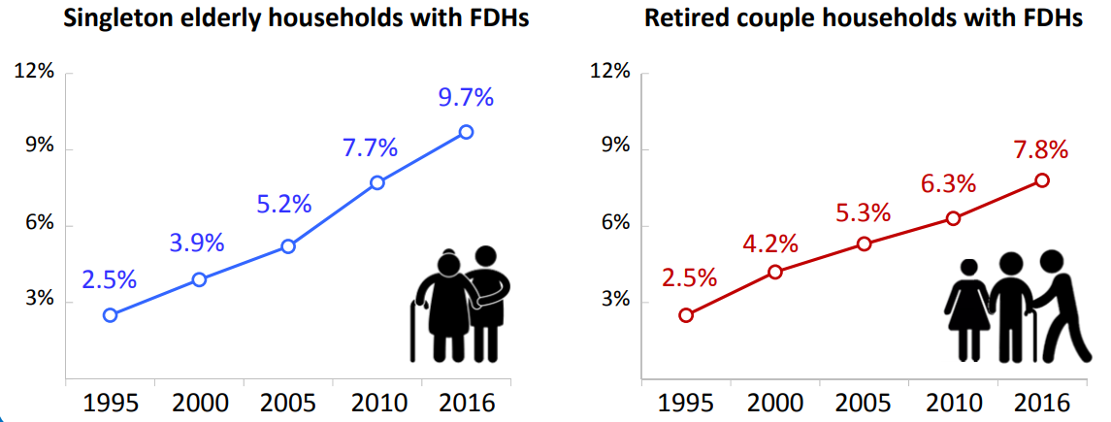
Introduction Foreign Domestic Helpers in HK
In Hong Kong, domestic helpers mainly
Come from Indonesia and the Philippines
Are female
Mandated to live with employers
Notes:
Census and Statistics Department. (2016) Annual Digest of Statistics 2016. Retrieved 21 July, 2018 from http://www.statistics.gov.hk/pub/B10100032016AN16B0100

Slide 6
Introduction Foreign Domestic Helpers in HK
Hong Kong: From 157,000 in 1996, FDHs increase to 352,000 in 2016, an increase of 124%
Reasons for increase :
Decreases in cohabitation with children
Busy life-styles
Increase in female employment rate
Insufficient state-funded long-term care services: 40,079 frail elders on waiting list for residential care, 20-months waiting time (Sept 2018).
FDHs provide around-the-clock care
Significantly lower salary levels than those of local helpers
Minimum monthly is HKD4,310 or US$553 (Labour Department, 2016)
Salary in HK is about 3 to 5 times that in the helpers’ own homeland, a big attraction to helpers
Notes:
Insufficient government-funded long-term care services, especially in terms of residential care: of September 2018, 40079 older adults were on the the waiting list for various types of subsidized residential care services, and the average waiting time was more than 20 months (Social Welfare Department, 2018)

Slide 7
Foreign Domestic Helpers and Ageing-in-Place: Strengths and Challenges
Study 1:
Examined the division of labour among primary family caregivers (PFCs) and foreign domestic helpers (FDHs) who came from Philippines or Indonesia
Examined the extent to which FDHs facilitate the ageing-in-place of elders suffering from physical or cognitive impairments
Explore services and measures that can support the FDHs in taking care of very frail elders at home

Slide 8
Study 1: Method
A qualitative study, conducted from 2013 to 2014.
Interviewed separately 16 matched triads in the same families (N=48):
Frail elders
primary family caregivers (PFCs),
foreign domestic helpers (FDHs) coming from Philippines/Indonesia
Trained interviewers using a semi-structured interview guide.
Using a grounded theory approach (Corbin & Strauss, 1990; Strauss & Corbin, 1998)

Slide 9
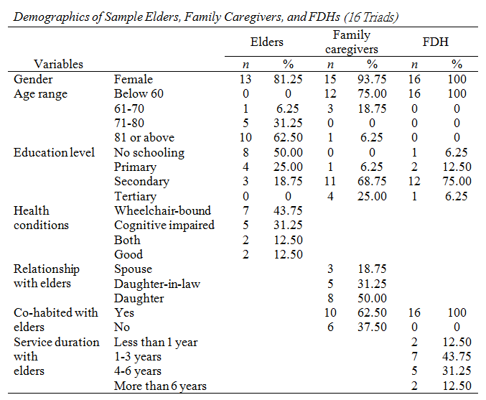
Study 1: Results

Slide 10
Division of Labour between FDHs and Family Caregivers
By foreign domestic helpers:
Mainly household chores especially cooking, escort elders to outdoor activities, personal care on a need basis
By family caregivers:
Financial management
Accompanying elder to medical consultation
Emotional support
Supervising and guiding domestic helper
Especially if there are some communication difficulties between the FDH and the elder
Take initiative to show concern the elders
E.g. purchase of daily necessaries, take turn to visit the elder

Slide 11
Can FDHs facilitate the aging-in-place?
A few elders and family members did not have long term plan
“I have not thought about this; we will decide when the time comes.”
The majority of frail elders, family caregivers and the FDHs are positive about the role of FDH in facilitating ageing-in-place
Most FDHs are responsible
FDHs willing to learn
Many FDHs (e.g. the Indonesian) could communicate well with the elders
Some FDHs could understand the frail or demented elders’ emotions and meanings better than their own children
FDHs could relieve caregiving distress and allowed personal space to family members
Hiring the FDHs instead of arranging institutionalisation
An elder said: “It is a lot better to live in my home, I feel happier here. Living in an institution would be so lonesome.” (1, E)

Slide 12
But, challenges faced by FDHs
A daughter said, “In the long run, I don’t think the maid could take care of my mum alone and we think the nurses in the aged care home have more professional knowledge and experience of taking care of her. At present, we hire an FDH as well as buy social services from a day care centre to take care of my mum. However, it would be very costly for us to sustain these for a long period of time… So, we would continue the present form of caregiving until we really can’t afford it.” (4, C-D)
Institutionalisation as the last resort:
Many FDHs faced difficulties :
Language barriers,
Family members’ over-reliance
Emotional exhaustion
A helper said, “I share the same bedroom with grandma. I need to take care of her round the clock. I don’t have any personal space. And I don’t have a real break! Sometimes, I really feel under great pressure!”(2, FDH)

Slide 13
Study 2: FDH and spousal caregiver distress
Aim: Examine the influence of domestic helpers on the relationship between stressors and spousal caregivers’ psychological distress
Stressors
Spousal Care Provision
Personal Care
Emotional Support
Care Receiver Care Needs
ADL Impairment
IADL Impairment
Cognitive Impairment
Bladder Incontinence
Bowel Incontinence
Problem Behavior
Outcome
Spousal Caregiver Distress
Moderator
Domestic Helper
Note. Control variables included care receiver characteristics, including gender, age, and education level
Notes:
The traditional reliance on family caregivers to care for frail elders has undergone significant changes due to socioeconomic shifts, including the rise of the nuclear family and an increase in the female employment rate. Instead of adult children or daughters-in-law providing care in keeping with traditional Eastern culture, spouses increasingly have been stepping into the role of caregiver (Chappell, 2008), possibly due to a decrease in cohabitation with children (Sugiura, Ito, Kutsumi, & Mikami, 2009).

Slide 14
Study 2: Method
A secondary analysis of cross-sectional data collected in Hong Kong between 2007 and 2009
6,442 Hong Kong elders (aged 60+)
Who were applying for state-funded long-term care services
Whose spouses were their primary caregivers
Adopted measures from the Hong Kong version of Minimum Data Set-Home Care (HK MDS-HC)
Notes:
The Hong Kong version of the Minimum Data Set-Home Care (HK MDS-HC), which is mandated by the government to determine the care needs of older adults and match them with appropriate services. The assessment draws on multiple sources, including direct questioning of care recipients and primary family caregivers, observation of care recipients in their home environment, and a review of secondary documents such as medical
records, if available.

Slide 15
Study 2: Respondents
Of the care receivers
73.04% were men (mean age = 76.9 years old)
5.73% had a domestic helper
Care receivers with a domestic helper
Generally more physically and cognitively impaired
Higher education levels (51.49% completed primary school or above)
39.19% of those without a domestic helper completed primary school or above
Approximately 44.16% of all spousal caregivers felt distressed

Slide 16
Study 2: Results
A logistic regression model with interaction terms of IVs and domestic helper was fit to the data (R² = .06)
Spousal caregivers who were women (β = 0.37; p < .001) and whose spouses were younger (β = −0.02, p < 0.001) were more distressed
Significant interaction effects of personal care and domestic helper (β = −0.43, p < .05).
i.e. assistance from a domestic helper might reduce the negative effects of providing personal care (e.g. dressing, hygiene, locomotion, toileting, and eating) on the psychological well-being of spousal caregivers
Significant interaction effects of cognitive impairment and domestic helper (β = 0.19, p < .05)
i.e. even with the assistance of a domestic helper, increased cognitive impairment among care recipients was associated with increased spousal psychological distress
Notes:
The severity of bowel incontinence (β = 0.11, p < .05) and problem behaviors (β = 0.33, p < .01) among care recipients generally increased their spousal caregiver’s likelihood of being distressed.

Slide 17
Study 3: Perception of work relation qualities between the elders and their FDHs
The elderly-FDH relationship is an intriguing topic because of its very unique nature
It lies in the border between formal work relationship in a work setting and an emotionally close relationship similar to kinship
The fact that the FDHs are co-residing with the elderly makes the work relationship between the elderly and the FDHs especially critical in affecting the wellbeing of the elderly
Aim: to examine the dyad’s perceived quality of their work relation

Slide 18
Study 3: Method
Participants
A cross-sectional survey of 123 dyads recruited from 23 community service units in HK in 2016
Elderly: 23 M (18.7%) and 100 F (81.3%) Chinese
Mean age: 84.93 years (SD = 6.29)
47.5% were independent or slightly dependent on assistance from others; 41.0% were moderately dependent, and 11.5% were severely dependent
Notes:
155 dyads of elderly and FDH were invited through 23 NGO service units (namely four district elderly community centers, seven neighborhood elderly centers, eight day care centers, two integrated home care service teams, one home for the aged, and one community center). Of which, ten elderly were severe intellectual impaired, nine were not capable to communicate, two were hospitalized, and four withdrew from the interview for personal reasons, and moreover, and seven FDHs withdrew after informed consent. Thus, only 123 days were successfully interviewed.

Slide 19
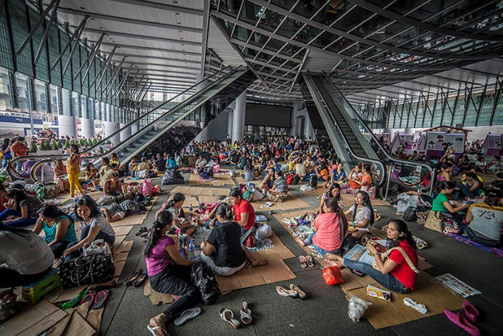
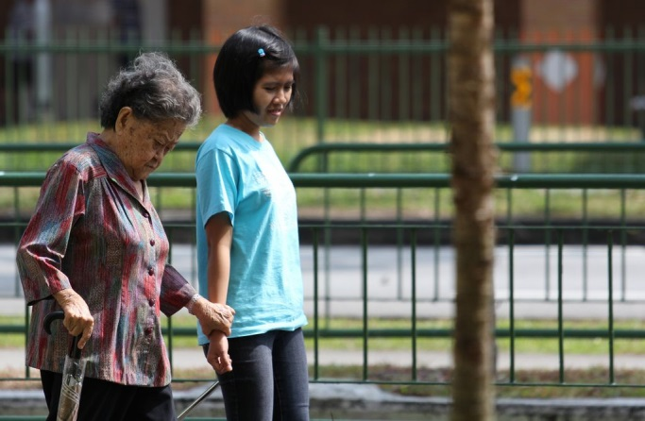
Study 3: Method
Participants
A cross-sectional survey on 123 dyads in 2016
All FDHs interviewed were female
Mean age: 37.45 years (SD = 8.24)
Majority (78.9%) from Indonesia
Had been working in Hong Kong for 7.95 years (SD = 5.56)
Had been working for current family for 2.58 years (SD = 2.47)

Slide 20
Study 3: Method
Measurements
Four dimensions of work relation (Ferris et al., 2009) are assessed, namely instrumentality, emotional support, trust, and affect. Same tools for both samples to facilitate comparsion.
Instrument support (as instrumentality)
Measured by 8-item subscale of Adult Toolbox Social Relationship Scales (Cyranowski et al., 2013)
“I have (FDH) to help me if I’m sick in bed ”
“I can get help cleaning up around my home if I need it ”
Notes:
To investigate the dyadic work relationship between the elderly and FDH, Ferris et al.’s (2009) conceptual framework is adopted in this study. In particular, building on the Leader-Member Exchange theory (Liden, Sparrowe, & Wayne, 1997) and Social Exchange Theory (Emerson, 1976), Ferris and colleagues (2009) argued that work relationship is affected by multiple dimensions such as instrumentality, trust, affect, and support. These dimensions play a critical role in developing a positive dyadic work relationship and influence the quality of dyadic interactions.

Slide 21
Study 3: Method
Measurements
Emotional support
Measured by 8-item subscale of Adult Toolbox Social Relationship Scales (Cyranowski et al., 2013)
“I have someone who understands my problems”
“I have (FDH)to talk with when I have a bad day”
Affect-based trust, and cognition-based trust (as trust)
Measured by Interpersonal Trust Measure (McAllister, 1995)
“We have a sharing relationship. We can both freely share our ideas, feelings, and hopes”
“I can talk freely to the elderly about difficulties I am having in life and know that he/she will want to listen”
“In the views of the elderly/primary caregiver, I approach my job with professionalism and dedication”
“The elderly can rely on me not to make his/her life more difficult by careless work”

Slide 22
Study 3: Method
Measurements
Social attraction, and task attraction (as affect)
Measured by two 5-item subscales of Interpersonal Attraction Measure (McCroskey & McCain, 1974)
“I think the elderly could be a friend of mine”
“I just wouldn’t fit into the elderly’s circle of friends”
“The elderly couldn't get anything accomplished with me”
“The elderly won’t regard me as a poor problem solver”
All scales use 5-point Likert format, the higher the score, the higher the value

Slide 23
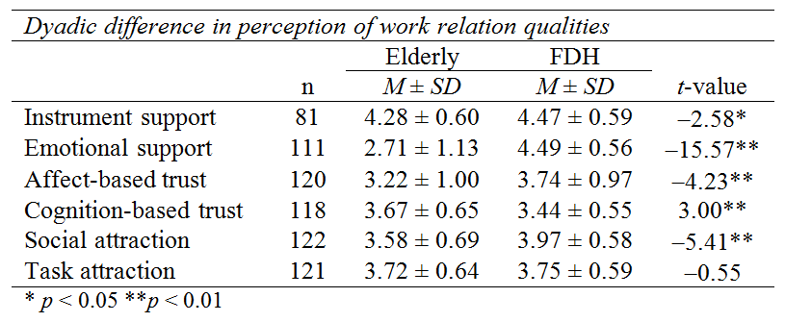
Study 3: Results
Dyadic perceptual differences
Paired t-tests revealed significant differences on all work relation qualities (except task attraction) perceived by elders and provided by FDHs

Slide 24
Study 3: Results
Dyadic perceptual differences
FDHs tended to claim that they provided more instrumental (t = −2.58, p < 0.05) and emotional supports (t = −15.57, p < 0.01), than that perceived by elders.
Elderly might tend to underestimate the support provided by FDHs, particular the emotional support.
Trust of FDHs towards elders was much likely affect-based (t = −4.23, p < 0.01), while trust of elderly towards FDHs was much likely cognition-based (t = 3.00, p < 0.01)
Social attraction, but not task attraction, was perceived as higher in FDHs (t = −5.41, p < 0.01), compared to elderly.

Slide 25
Study 3: Discussion & conclusion
The study finds dyadic discrepancies in perceived work relation qualities
Elderly might tend to underestimate the emotional support provided by FDHs
Trust of elderly towards FDHs was more likely to be cognition-based, suggesting a need to build a wholistic sense of trust among elders.
Possible misunderstanding or mismatch between elderly and FDHs in their expectation on their relationship: elders tend to be more task-oriented, while FDHs tend to be more social-oriented.

Slide 26
Conclusion: a Viable Alternative Long-term Care Option
FDHs can provide daily care to frail elders, but the family caregivers still need to take up some caregiving tasks
FDHs not only took care of frail elders, but also reduce caregiving distress of spousal caregivers.
FDHs could facilitate ageing-in-place
Allowing elders to remain living in the area with which they are familiar for as long as they wish (Heuman & Boldy, 1993; Holosko & Feit, 2004)
Can reduce premature institutionalization of frail elders.
Care by FDHs promises to be an alternate long term care model in addition to community care, residential care:
FDHs may help to fulfill traditional cultural expectations of caring for frail elders at home without overburdening family caregivers
Notes:
Study findings may be generalized to other industrialized societies—especially those with a large Chinese population such as Singapore, Taiwan, and Canada—that
share similar socioeconomic and contextual factors such as rapid population aging, high female employment rates, and reliance on domestic helpers (Chau et al., 2012).
For countries in which domestic helpers are not as prevalent, findings indicate the contribution of secondary caregivers to reducing the distress of spousal caregivers during the caregiving process.

Slide 27
Yet, DHs face challenges
language barriers,
over-reliance of family members, and emotional exhaustion.
Not know how to take care of elders with greater cognitive impairment, possibly due to their lack of training
How to support FDHs in taking care of frail elders?
Let’s look at what other societies are doing in terms of policy and services

Slide 28
Overseas Foreign Domestic Helpers Related Policies

Slide 29
Financial supports/subsidies for employing FDHs
Singapore
Tax reductions, monthly concession (S$205) and Foreign Domestic Worker Grant (S$120, for low or middle income families) are provided to families with elders to employ FDHs
Taiwan
Living allowance and exemption from Employment Security Fee for the low or middle income families
Canada and Northern Europe
Minimum wage and insurance cover to protect FDHs’ rights
Notes:
HKCSS. (2018). Policy Bulletin. 24. Retrieved from http://www.hkcss.org.hk/uploadFileMgnt/0_201841611018.pdf
HKSAR Legislative Council. (2017). Research Brief. 4.

Slide 30
Training on elderly care for FDHs
Singapore
“Caregiver’s Training Grant” with allowance up to S$200 and “Eldercarer Foreign Domestic Worker Scheme”
Taiwan
FDHs are required to receive at least 90 hours of training in care service and to attend 24-70 hours of Chinese language training prior to working visa application
Employers can further apply self-finance additional training for their FDHs
Japan
FDHs are required to pass nursing or care worker certification examinations (in Japanese) within 4 years of entry.
Notes:
Eldercarer Foreign Domestic Worker Scheme: The training programme covers (i) two-day classroom training on elderly care before reporting duties; and (ii) on-the-job training for three hours after commencement of the care work. Training cost varies from S$200 (HK$1,124) to S$500 (HK$2,810), depending on the employment agency and type of training the helper required.
HKCSS. (2018). Policy Bulletin. 24. Retrieved from http://www.hkcss.org.hk/uploadFileMgnt/0_201841611018.pdf
HKSAR Legislative Council. (2017). Research Brief. 4.

Slide 31
Residency as reward (with government terms and regulations)
Canada
“Live-In Caregiver Program (LIC)” (Ended in 2014): Applicants through this program were eligible to apply for Permanent Residence (PR) status after working a minimum of two years within four years of their arrival (plus three months).
New caregiver program: Being a caregiver of (i) children or/and (ii) people with high medical needs. Need to work in Canada with a work permit in an eligible occupation for two years and meet requirements for language ability and education.

Slide 32
Residency as reward (with government terms and regulations)
Sweden
As long as FDHs are eligible to fulfil the employment agreements/ practices stated by the government, the initial residence and work permits are granted for maximum two years with possibility to extend the permit with two other years. After four years a permanent residence permit can be granted.
Finland
FDHs must apply for a Finnish residence permit in their domicile or the country in which they legally reside before entering Finland
First residence permit can be granted for a maximum of one year. An extension to the permit can then be applied for
Notes:
European Migration Network. (2010). Ad-Hoc Query on Overseas Domestic Workers. Retrieved from https://ec.europa.eu/home-affairs/sites/homeaffairs/files/what-we-do/networks/european_migration_network/reports/docs/ad-hoc-queries/protection/167._emn_ad-hoc_query_overseas_domestic_workers_2nov2009_wider_dissemination_en.pdf

Slide 33
Policy Recommendations
Support measures are strongly recommended to strengthen the caregiving abilities of FDHs:
Training of knowledge (especially knowledge on illnesses common in late life, e.g., diabetes, stroke, renal disease etc.)
Skills training: in taking care of the elders with physical or cognitive impairment, in cooking, personal care, medication principles.
handling the negative emotions of the elders who are having deteriorating health
When? Preferably training before coming to HK, or immediately upon arrival to HK, e.g., 1 session/week.

Slide 34
Cantonese training is recommended to facilitate communication with elders. This can take the form of apps, since most FDHs are skillful with their mobile phone.
Financial support from the government to FDHs having received relevant training
in recognition of training
Tax exemption is not practical since FDH salary is mostly shared among a few family members.
Family members should be encouraged to show appreciation & provide support to FDHs.

Slide 35
Reference
Ayalon, L. (2009). Family and family-like interactions in households with round-the-clock paid foreign carers in Israel. Ageing and Society, 29(5), 671-686.
Chong, A. M. L., Kwan, C. W., Chi, I., Lou, V. W. Q., & Leung, A. Y. M. (2014). Domestic helpers as moderators of spousal caregiver distress. Journals of Gerontology, Series B: Psychological Sciences and Social Sciences, 69, 966 – 972.
European Migration Network. (2010). Ad-Hoc Query on Overseas Domestic Workers. Retrieved from https://ec.europa.eu/home-affairs/sites/homeaffairs/files/what-we-do/networks/european_migration_network/reports/docs/ad-hoc-queries/protection/167._emn_ad-hoc_query_overseas_domestic_workers_2nov2009_wider_dissemination_en.pdf
Ferris, G. R., Liden, R. C., Munyon, T. P., Summers, J. K., Basik, K. J., & Buckley, M. R. (2009). Relationships at work: Toward a multidimensional conceptualization of dyadic work relationships. Journal of Management, 35(6), 1379-1403.
HKCSS. (2018). Policy Bulletin. 24. Retrieved from http://www.hkcss.org.hk/uploadFileMgnt/0_201841611018.pdf
HKSAR Census and Statistics Department. (2016) Annual Digest of Statistics 2016.
HKSAR Census & Statistics Department. (2017). Hong Kong Population Projections 2017-2066.
HKSAR Legislative Council. (2017). Research Brief. 4.
Japan International Corporation of Welfare Services (JICWELS). 2015. EPA ni yoru Gaikokujin Kaigofukushishi oyobi Dokohosha ukeire no Genjo oyobi Kadai [The Situation and Issues related to the Intake of Foreign Care Workers and Related Applicants]
Keryk, M. (2010). Caregivers with a heart needed: The domestic care regime in Poland after 1989 and Ukrainian migrants. Social Policy and Society, 9(3), 431-441.

Slide 36
My email:
alice.chong@cityu.edu.hk

